Slide 1
Insurance Claims & Policyholder Risk Analysis Dashboard
Name-: Ankit Kumar
Data Analyst(upGrad)
Email-: ankitkumar15614@gmail.com

Slide 2
1.Overview of the Dashboard
This dashboard provides insights into insurance claims, policyholder risk factors, and claim severity. It is designed to help insurers analyze trends, optimize pricing, and make data-driven decisions. The key metrics include total claims, average claim amount, total claim adjustment, and claim severity distribution.

Slide 3
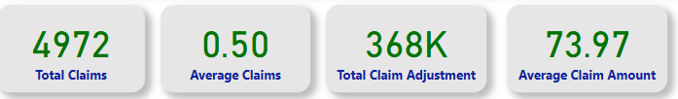
2. Key Metrics & Insights
Total Claims: 4,972
Average Claims per Policyholder: 0.50
Total Claim Adjustment: 368K
Average Claim Amount: 73.97

Slide 4
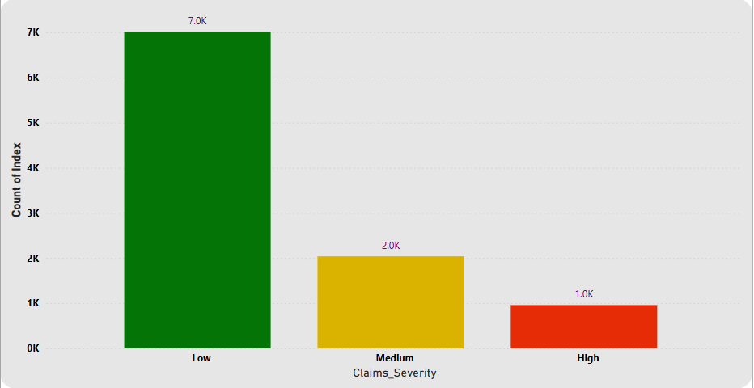
3. Detailed Explanation of Each Visualization
a. Count of Records by Claims Severity
Description: This bar chart categorizes claims into Low, Medium, and High severity.
Insights: Low-severity claims are the most frequent, followed by Medium and High severity claims.
Impact: Insurers may focus on reducing high-severity claims through better risk management.

Slide 5
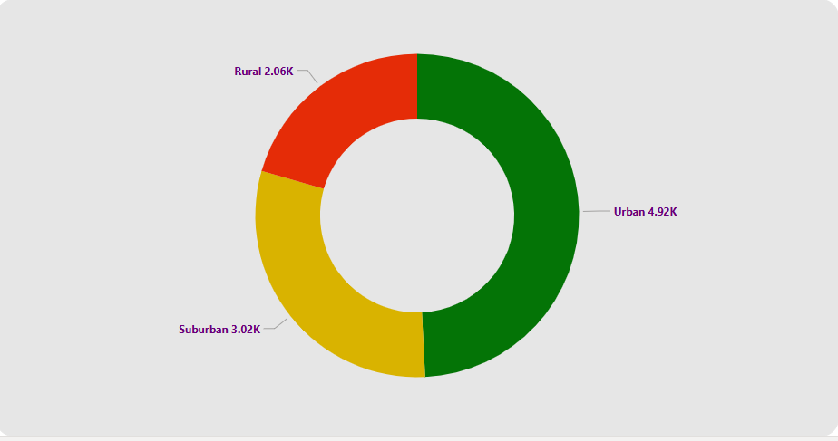
3. Detailed Explanation of Each Visualization
b. Count of Records by Regions
Description: This donut chart represents claims distribution across Urban, Suburban, and Rural areas.
Insights: The Urban region has the highest claims (4.92K), followed by Suburban (3.02K) and Rural (2.06K).
Impact: Urban areas might pose higher risks, requiring premium adjustments.

Slide 6
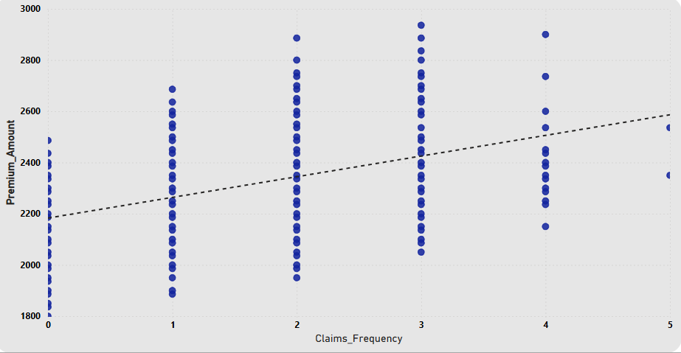
3. Detailed Explanation of Each Visualization
c. Claims Frequency vs. Premium Amount
Description: A scatter plot showing the relationship between claim frequency and premium amount.
Insights: Higher claim frequency often correlates with higher premiums.
Impact: Helps in pricing adjustments for policyholders with frequent claims.

Slide 7
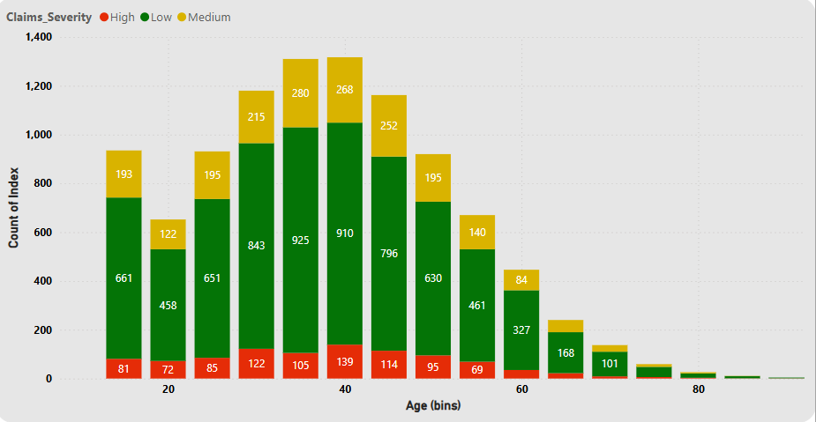
3. Detailed Explanation of Each Visualization
d. Count of Records by Age (Bins) and Claims Severity
Description: A bar chart showing claim severity across different age groups and create a bins of age group of (0-5) years.
Insights: Younger policyholders may have more low-severity claims, while older groups may have varied severity levels.
Impact: Insurers can adjust policies based on age-based risk profiles.

Slide 8
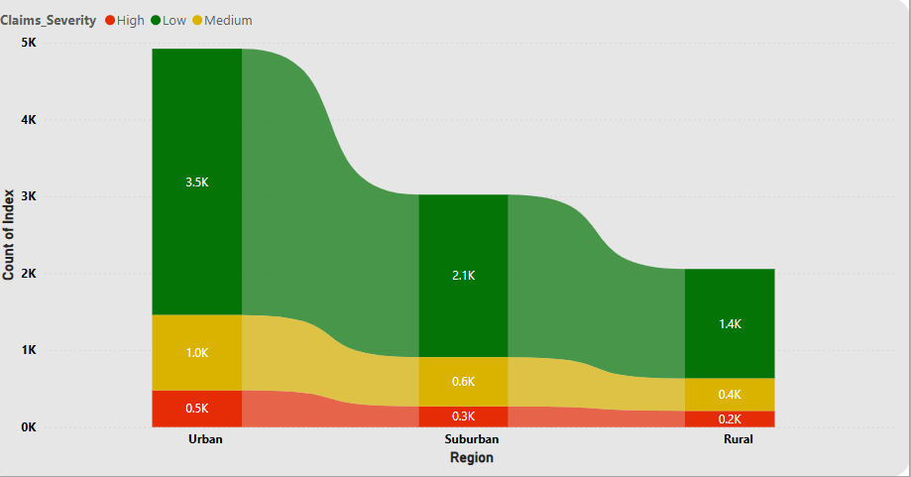
3. Detailed Explanation of Each Visualization
e. Claims Severity by Region
Description: A stacked bar chart displaying the severity of claims across Urban, Suburban, and Rural areas.
Insights: Urban areas have the highest severe claims, while Rural areas have fewer high-severity claims.
Impact: Insurance companies can tailor risk management strategies per region.

Slide 9
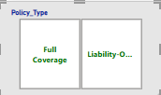
4. Filters Used in the Dashboard
Filters help users refine and analyze specific subsets of data, enabling a more focused approach to decision-making. The following filters are available in the dashboard:
a. Policy Type
Options: Full Coverage, Liability-Only
Purpose: Allows users to compare claim trends based on coverage type. Full Coverage policies may have different claim frequencies and severities compared to Liability-Only policies.

Slide 10
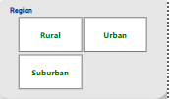

4. Filters Used in the Dashboard
b. Region
Options: Urban, Suburban, Rural
Purpose: Helps analyze regional variations in claims, assisting in risk assessment and pricing strategies.
c. Marital Status
Options: Single, Married, Divorced, Widowed
Purpose: Identifies trends in claim filings based on marital status, which can impact policyholder risk profiles

Slide 11

4. Filters Used in the Dashboard
d. Source of Lead
Options: Agent, Referral, Online
Purpose: Examines whether different lead sources correlate with claim frequency or severity.
Filters enable dynamic analysis, allowing users to explore data from various perspectives and derive actionable insights

Slide 12
5. Analysis and Interpretation
Urban policyholders file more claims, which may indicate higher risk levels.
Frequent claimants tend to pay higher premiums, as shown in the claims frequency vs. premium amount scatter plot.
Age plays a role in claim severity, with younger individuals filing lower-severity claims more frequently.
Policy types and marital status impact claim behavior, which insurers can use for policy adjustments.

Slide 13
6. Key Takeaways & Recommendations
Risk-Based Pricing: Adjust premiums based on claim severity trends by age and region.
Fraud Detection: Analyze frequent high-severity claims for possible fraudulent activities.
Policy Optimization: Modify coverage options to reduce high-severity claims.
Customer Education: Inform policyholders about safe practices to reduce claim frequency.

Slide 14


